Slide 1
Putting it all Together
Sonika Verma
CSCD92: Final Week

Slide 2
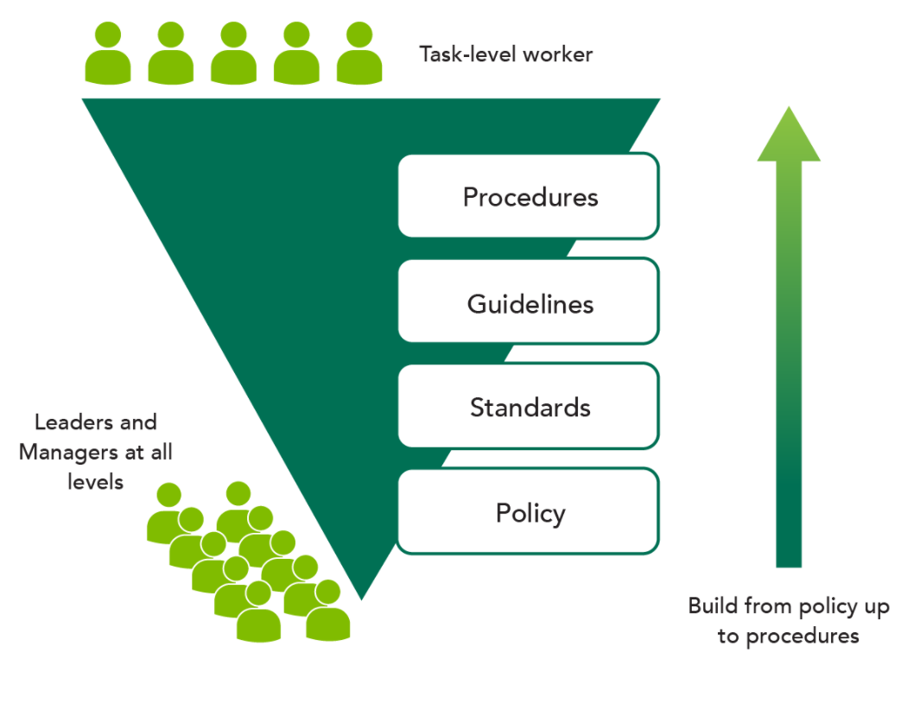
Administrative Control Set
Governance & alignment
Administrative controls
Policies, procedures, guidelines, standards
Frameworks

Slide 3
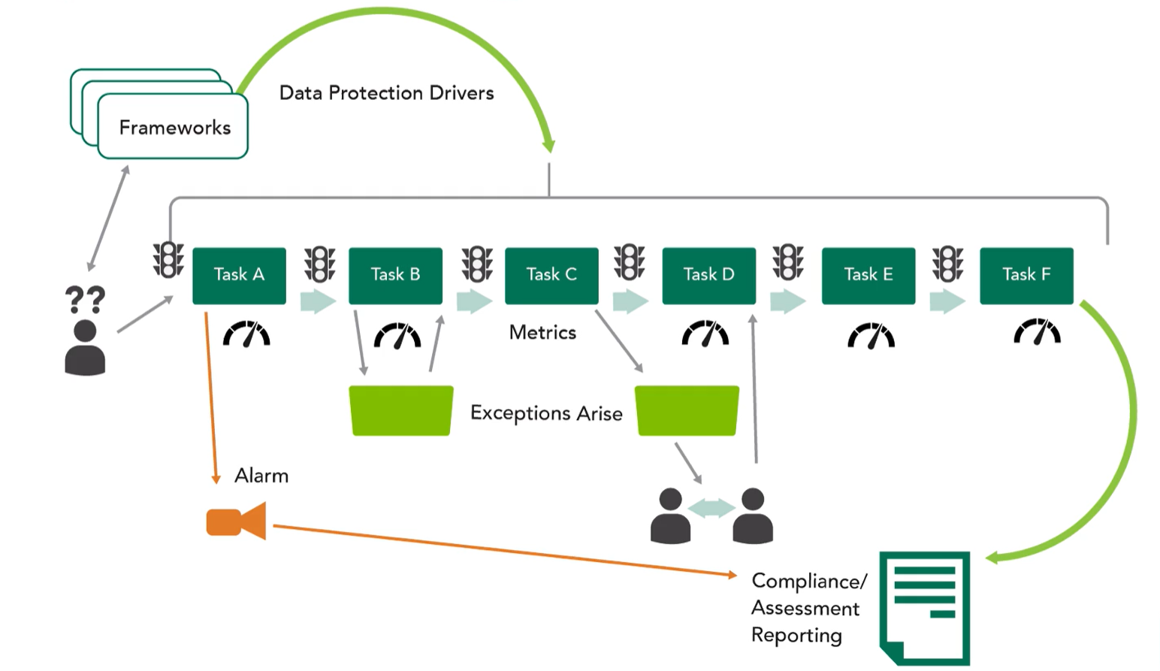
Operational Security Frameworks
Operationalizing frameworks
Privacy frameworks Cybersecurity frameworks Risk frameworks Security control frameworks

Slide 4
Forensic Investigations
Maintaining integrity
Evidence collection and handling
Artifact
Chain of custody, chain of evidence
Investigative techniques
Digital forensic principles
Types of investigations
Administrative
Civil
Regulatory
Criminal

Slide 5
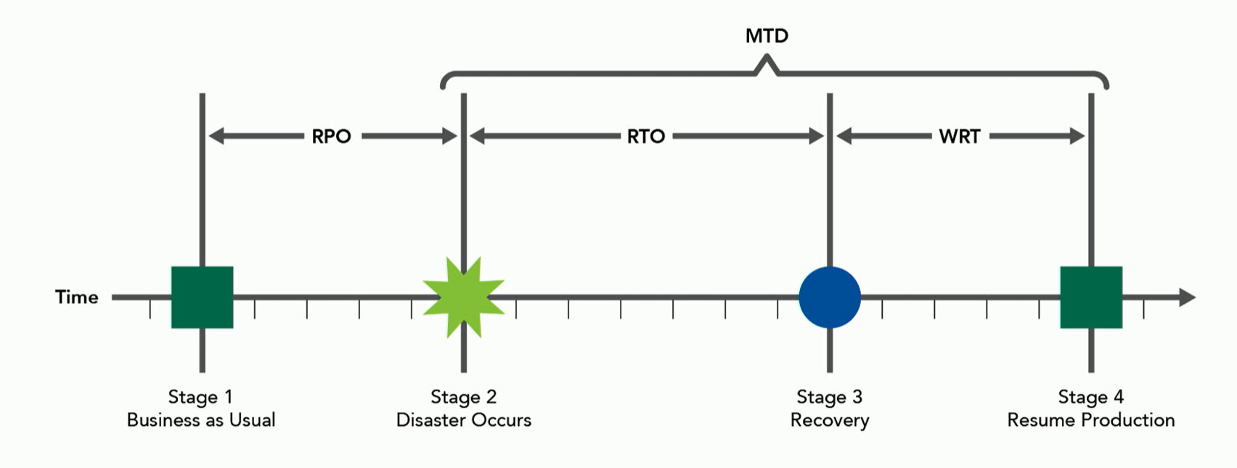
Business Continuity, Disaster Recovery, Organizational Capacity
Business continuity
business continuity planning
Disaster recovery
Implementing disaster recovery
Business impact analysis
Planning factors
MAD, RTO, RPO
Compliance requirements
BC/DR exercises

Slide 6
Personnel Security Policy and Procedures
Candidate screening and hiring
Employee agreements and policies
Onboarding, transfers, terminations
Compliance and privacy policy requirements
NDAs
Contractual protections

Slide 7
Operationalizing Risk Management
Risk management activities
Risk
Risk mitigation
Risk avoidance
Risk transference
Risk acceptance
Residual risk
Risk exposure
Threat modeling

Slide 8
Security Controls
Technical/logical, administrative, physical controls
Directive, deterrent, preventative, compensating, detective, corrective, recovery
Defense-in-depth
Key performance indicators
 | Preventative | Detective | Corrective | Deterrent | Recovery | Compensating
Physical Controls | Locks, badge system, security guards, biometric system, | Motion detectors, closed-circuit TV’s |  | Fences, lighting | Offsite facility | All listed
Administrative Controls | Security policy, separation of duties, information classification, testing, security awareness training | Monitoring and supervision, job rotation, investigations |  | Contractual obligations, enforcement |  | All listed
Technical Controls | Routers, encryption, antivirus, smart cards, dial-up call-back systems | Audit logs, IDs | Antivirus, server images |  | Data backup | All listed

Slide 9
IT Supply Chain Risk Management
Hardware, software, services
Third-party assessments
Minimum security requirements
Industry standards, best practices, frameworks
Contractual obligations
Service level agreements

Slide 10
Security Awareness, Education, and Training
Methods & techniques
Periodic content reviews
Program effectiveness evaluation

